Slide 1
Energy Flow Through an Ecosystem
Food Chains and Food Webs

Slide 2
Food Chain Foldable
Fold your paper in half “hot dog” style
Fold it again the same way so that you have a long skinny paper
Fold your paper into thirds the other direction

Slide 3
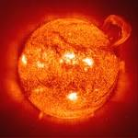
Sunlight is the source of Energy for almost all living things
Star at the center of our solar system, we call it the Sun

Slide 4



PRODUCERS
Organisms that use the sunlight directly to make food (converts sunlight into energy through photosynthesis.

Slide 5
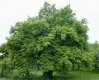
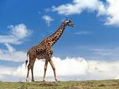
They use most of the energy they produce, what is left goes to the next organism

Slide 6
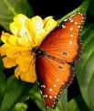
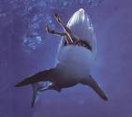
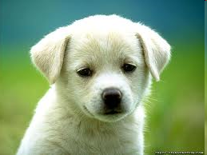
CONSUMERS
Organisms that eat other organisms

Slide 7
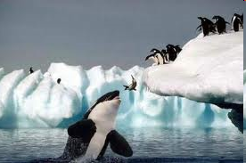
Consumers that hunt & kill other consumers are called predators.
The animals that are hunted & killed are called prey.

Slide 8
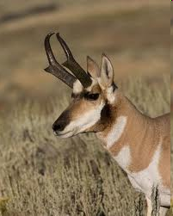
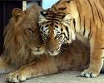
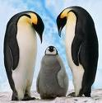



Slide 9
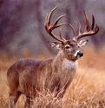
Consumers that eat producers
Are called herbivores
Herbivores eat plants

Slide 10
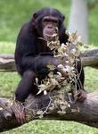
Consumers that eat producers & other consumers
Are called omnivores
Omnivores eat plants and animals

Slide 11
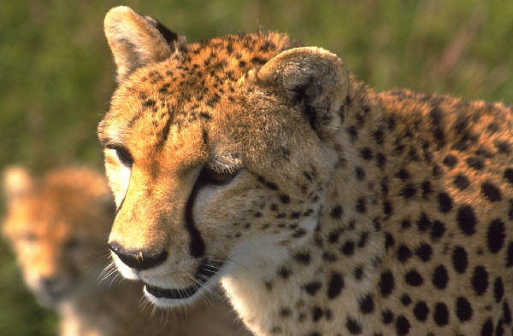
Carnivores are consumers that eat other animals.

Slide 12
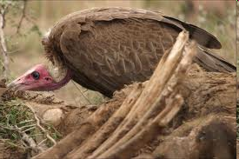
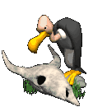
Consumers that eat other consumers that have already died are called scavengers.

Slide 13
FOOD CHAIN
The transfer of energy from sun to producer to consumer

Slide 14
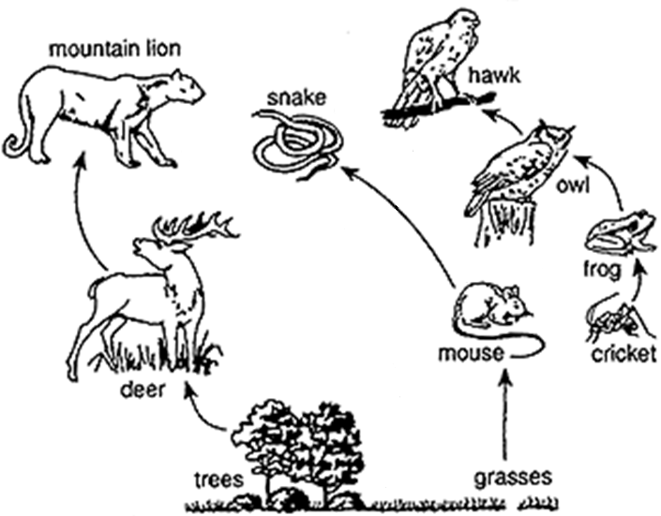
Still just food chains…

Slide 15
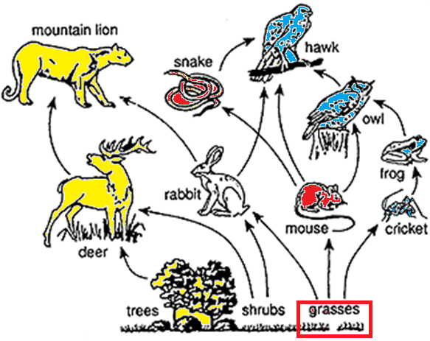
Food Webs:
Interconnected food chains
They show the feeding relationships in an ecosystem

Slide 16
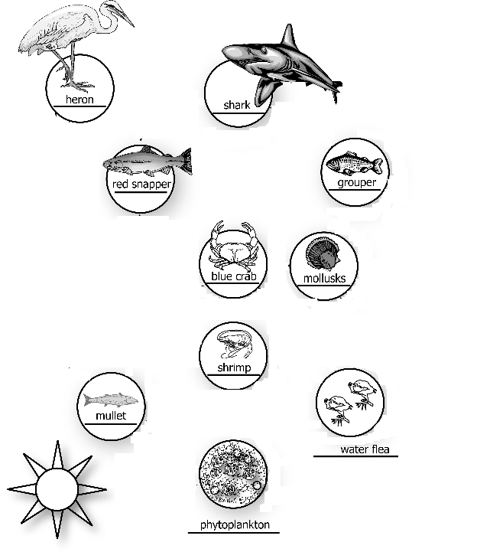
Marine Food Web
Where does the energy start?

Slide 17
Marine Food Web
Energy starts at the Sun (the source of energy for almost all living things)
What organism can use the energy directly from the sun?

Slide 18
Marine Food Web
Producers use the sunlight directly to make food.
Converts sunlight to energy through photosynthesis
What is being transferred from the sun to the plant and how do we show that in a food web?

Slide 19
Marine Food Web
Energy is transferred from the sun to the producers.
We show this with an arrow that points to where the energy is going to.
Where will the energy go to next?

Slide 20
Marine Food Web
The energy can go next to the mollusks, shrimp, mullet, and water fleas because they eat phytoplankton
Show the energy transfer to those organisms
Where will the energy go to next?

Slide 21
Marine Food Web
The energy can go next to the mollusks, shrimp, mullets, and blue crab because they water fleas.
Show the energy transfer to those organisms
How else are these organisms connected?

Slide 22
Marine Food Web
The energy can also go to the blue crab because they eat the mullets, shrimp, and mollusks.
Show the energy transfer to those organisms
Where will the energy go to next?

Slide 23
Marine Food Web
The energy can also go next to the heron, red snapper, and grouper because they eat the mullets, shrimp, and mollusks.
Show the energy transfer to those organisms
Where can the energy go to next?

Slide 24
Marine Food Web
Finally the energy goes to the shark because they eat grouper and red snapper.
Show the energy transfer to those organisms
Now you have a complete food web!!

Slide 25
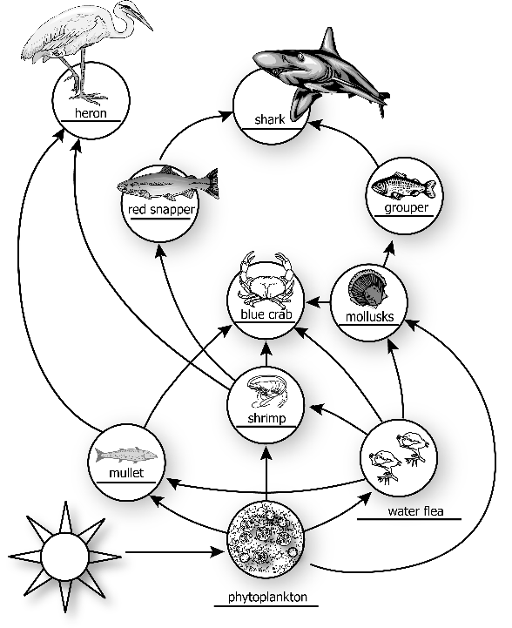

Slide 26
Create your own food web…
On a separate sheet of paper you will create your own food web, from a list of organisms provided.
Start at the bottom with the producers and work your way up.
Along with the name of each organism, create a picture of that animal (pictures do not have to be perfect, stick figures will do)
Organisms
Insert list of animals that your students will be familiar with

