Slide 1
Unit 4 Lesson 2 Clouds and Cloud Formation
Copyright © Houghton Mifflin Harcourt Publishing Company

Slide 2
Unit 4 Lesson 2 Clouds and Cloud Formation
Head in the Clouds
What are clouds?
A cloud is a collection of small water droplets or ice crystals that are suspended in the air.
Clouds are visible because water droplets and ice crystals reflect light.
Clouds are usually associated with precipitation, but most cloud types do not produce precipitation.
Copyright © Houghton Mifflin Harcourt Publishing Company

Slide 3
Unit 4 Lesson 2 Clouds and Cloud Formation
How do clouds affect climate?
The pattern of precipitation from clouds in an area will determine the climate of that area.
Thick, low-altitude clouds reflect more sunlight back into space and help to cool Earth.
Thin, high-altitude clouds absorb some energy that radiates from Earth and reradiate some of it back to Earth’s surface. This warms Earth.
Copyright © Houghton Mifflin Harcourt Publishing Company

Slide 4
Unit 4 Lesson 2 Clouds and Cloud Formation
How do clouds form?
Clouds form when water vapor condenses, or changes from a gas to a liquid.
For water vapor to condense, moist air must be cooled to a certain temperature, and the air must be holding the maximum amount of water vapor possible.
If air rises high enough into the atmosphere, it cools to its dew point.
Copyright © Houghton Mifflin Harcourt Publishing Company

Slide 5
Unit 4 Lesson 2 Clouds and Cloud Formation
How do clouds form?
Dew point is defined as the temperature at which the rate of condensation equals the rate of saturation.
Saturation means that the air is holding the maximum quantity of water vapor possible at a given temperature or pressure.
Dew point is the temperature at which water vapor in saturated air can condense and form water droplets or ice crystals.
Copyright © Houghton Mifflin Harcourt Publishing Company

Slide 6
Unit 4 Lesson 2 Clouds and Cloud Formation
How do clouds form?
In clouds, tiny solid particles called cloud condensation nuclei are the surfaces on which water droplets condense.
Clouds are most commonly made of numerous small water droplets.
However, at high altitudes, where temperatures are very cold, clouds are composed of ice crystals.
Copyright © Houghton Mifflin Harcourt Publishing Company

Slide 7
Unit 4 Lesson 2 Clouds and Cloud Formation
What is the role of solar energy in cloud formation?
Solar energy drives the water cycle and thus provides the energy for cloud formation.
Water on the surface of the land and the oceans absorbs solar energy and becomes water vapor, in a process called evaporation.
Cloud formation takes place when water droplets or ice crystals condense on solid particles in the air.
Copyright © Houghton Mifflin Harcourt Publishing Company

Slide 8
Unit 4 Lesson 2 Clouds and Cloud Formation
What processes cool air enough to form clouds?
Air can be cooled to its dew point in several ways, including frontal and orographic lifting.
Frontal lifting can occur when a warm air mass rises over a cold air mass, or when a mass of cold air slides under a mass of warm air.
Orographic lifting occurs when an obstacle, such as a mountain range, forces a mass of air upward.
Copyright © Houghton Mifflin Harcourt Publishing Company

Slide 9
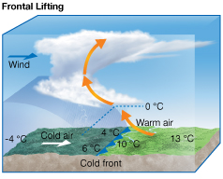
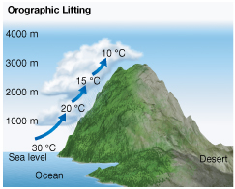
Unit 4 Lesson 2 Clouds and Cloud Formation
What processes cool air enough to form clouds?
In what ways are the processes of frontal lifting and orographic lifting similar? In what ways are they different?
Copyright © Houghton Mifflin Harcourt Publishing Company

Slide 10
Unit 4 Lesson 2 Clouds and Cloud Formation
What are three cloud shapes?
The three classes of clouds based on shape are stratus, cumulus, and cirrus clouds.
Stratus clouds are thin and flat, and their edges are not clearly defined.
Stratus is a Latin word that means “layer.” Stratus clouds often merge into one another and may look like a single layer that covers the entire sky.
Copyright © Houghton Mifflin Harcourt Publishing Company

Slide 11
Unit 4 Lesson 2 Clouds and Cloud Formation
What are three cloud shapes?
Cumulus is a Latin word that means “heap.”
Cumulus clouds are thick and puffy on top and generally flat on the bottom.
These clouds have well-defined edges and can change shape rapidly. They can be bright or dark, and they can produce severe weather.
Copyright © Houghton Mifflin Harcourt Publishing Company

Slide 12
Unit 4 Lesson 2 Clouds and Cloud Formation
What are three cloud shapes?
Cirrus is a Latin word that means “curl.”
Cirrus clouds look white and feathery, and their ends curl.
They are made of ice crystals rather than liquid water droplets. They do not produce precipitation that reaches Earth’s surface.
Copyright © Houghton Mifflin Harcourt Publishing Company

Slide 13
Unit 4 Lesson 2 Clouds and Cloud Formation
I’ve Looked at Clouds from Both Sides Now
What are the types of clouds based on altitude?
The four classes of clouds based on altitude are low clouds, middle clouds, high clouds, and clouds of vertical development.
These four classes are made up of 10 cloud types.
Prefixes are used to name the clouds that belong to some of these classes.
Copyright © Houghton Mifflin Harcourt Publishing Company

Slide 14
Unit 4 Lesson 2 Clouds and Cloud Formation
What are the types of clouds based on altitude?
Low clouds form between Earth’s surface and 2,000 m altitude. They are commonly made up of water droplets.
The three types of low clouds are stratus, stratocumulus, and nimbostratus.
There is no special prefix for naming low clouds. However, nimbus means “rain,” so nimbostratus clouds are rain clouds.
Copyright © Houghton Mifflin Harcourt Publishing Company

Slide 15
Unit 4 Lesson 2 Clouds and Cloud Formation
What are the types of clouds based on altitude?
Middle clouds form between 2,000 m and 6,000 m altitude. They are commonly made up of water droplets, but may be made up of ice crystals.
The prefix alto- is used to name middle clouds.
The two types of middle clouds are altocumulus and altostratus.
Copyright © Houghton Mifflin Harcourt Publishing Company

Slide 16
Unit 4 Lesson 2 Clouds and Cloud Formation
What are the types of clouds based on altitude?
High clouds form above 6,000 m altitude, where air temperature is below freezing. Therefore, high clouds are made up of ice crystals.
The prefix cirro- is used to name high clouds.
Cirrus, cirrocumulus, and cirrostratus are the types of high clouds.
Copyright © Houghton Mifflin Harcourt Publishing Company

Slide 17
Unit 4 Lesson 2 Clouds and Cloud Formation
What are the types of clouds based on altitude?
A cloud of vertical development can have its base at low altitude, but its top can reach higher than 12,000 m.
The two types of clouds of vertical development are cumulus and cumulonimbus.
Cumulonimbus clouds are linked to severe weather and can produce rain, hail, lightning, tornadoes, and rapidly sinking columns of air.
Copyright © Houghton Mifflin Harcourt Publishing Company

Slide 18
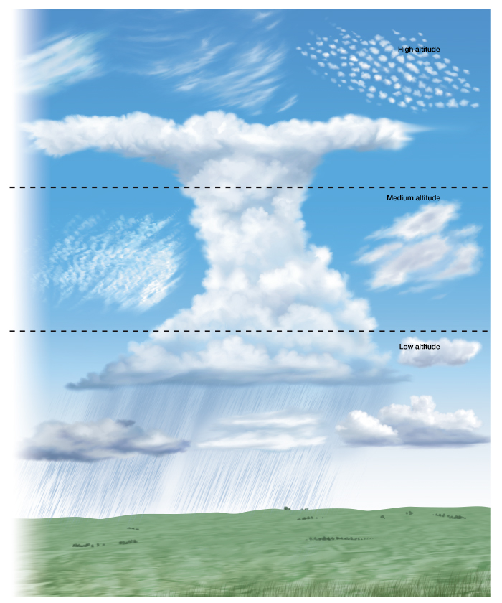
Unit 4 Lesson 2 Clouds and Cloud Formation
What are the types of clouds based on altitude?
Identify the various types of clouds shown here.
Copyright © Houghton Mifflin Harcourt Publishing Company

Slide 19
Unit 4 Lesson 2 Clouds and Cloud Formation
How does fog form?
Water vapor that condenses very near Earth’s surface is called fog. It forms when moist air near Earth’s surface or moving across cold water cools to its dew point.
Ground fog, or radiation fog, generally forms in low-lying areas on clear, calm nights. Sea fog, or advection fog, occurs at all times of day.
Steam fog forms when evaporation takes place into cold air that is lying over warmer water.
Copyright © Houghton Mifflin Harcourt Publishing Company

Slide 20
Unit 4 Lesson 2 Clouds and Cloud Formation
Clouds on Other Worlds
Like Earth, other bodies in the solar system have clouds in their atmosphere.
There are clouds on Venus, Mars, Jupiter, and Saturn. The clouds of Jupiter and Saturn are arranged in bands that circle the planets.
Saturn’s moon Titan has clouds in a thick, planet-like atmosphere.
Copyright © Houghton Mifflin Harcourt Publishing Company

